Slide 1





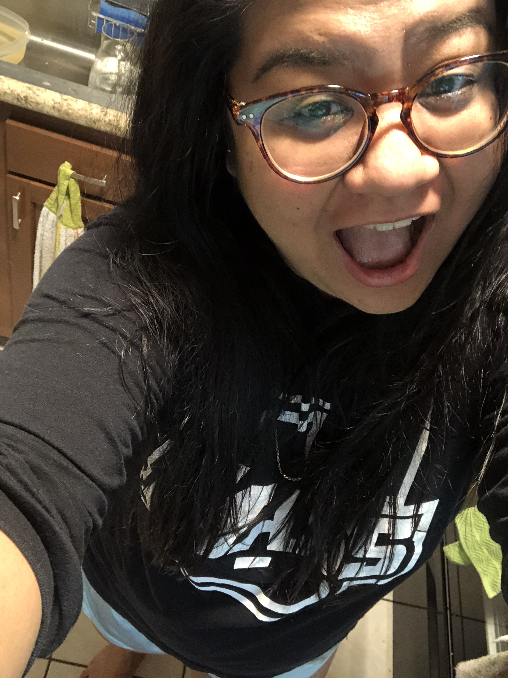
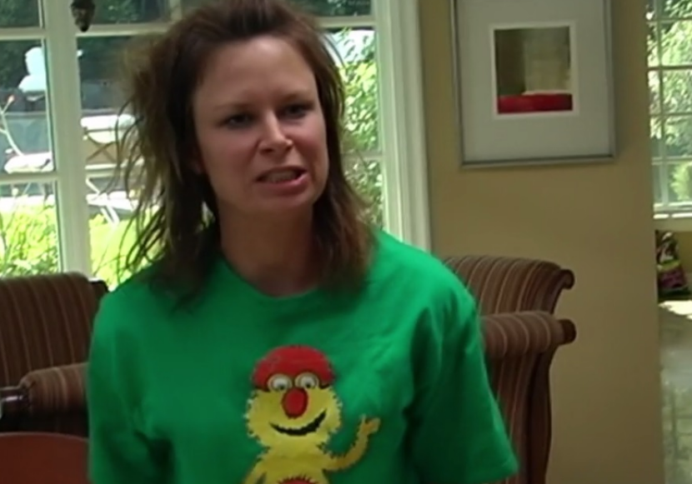


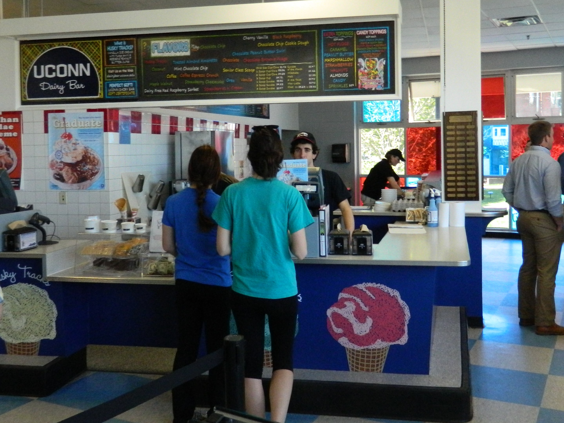
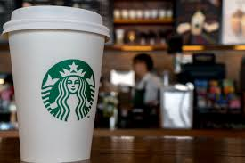

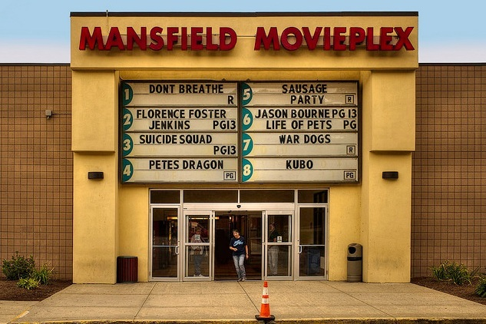
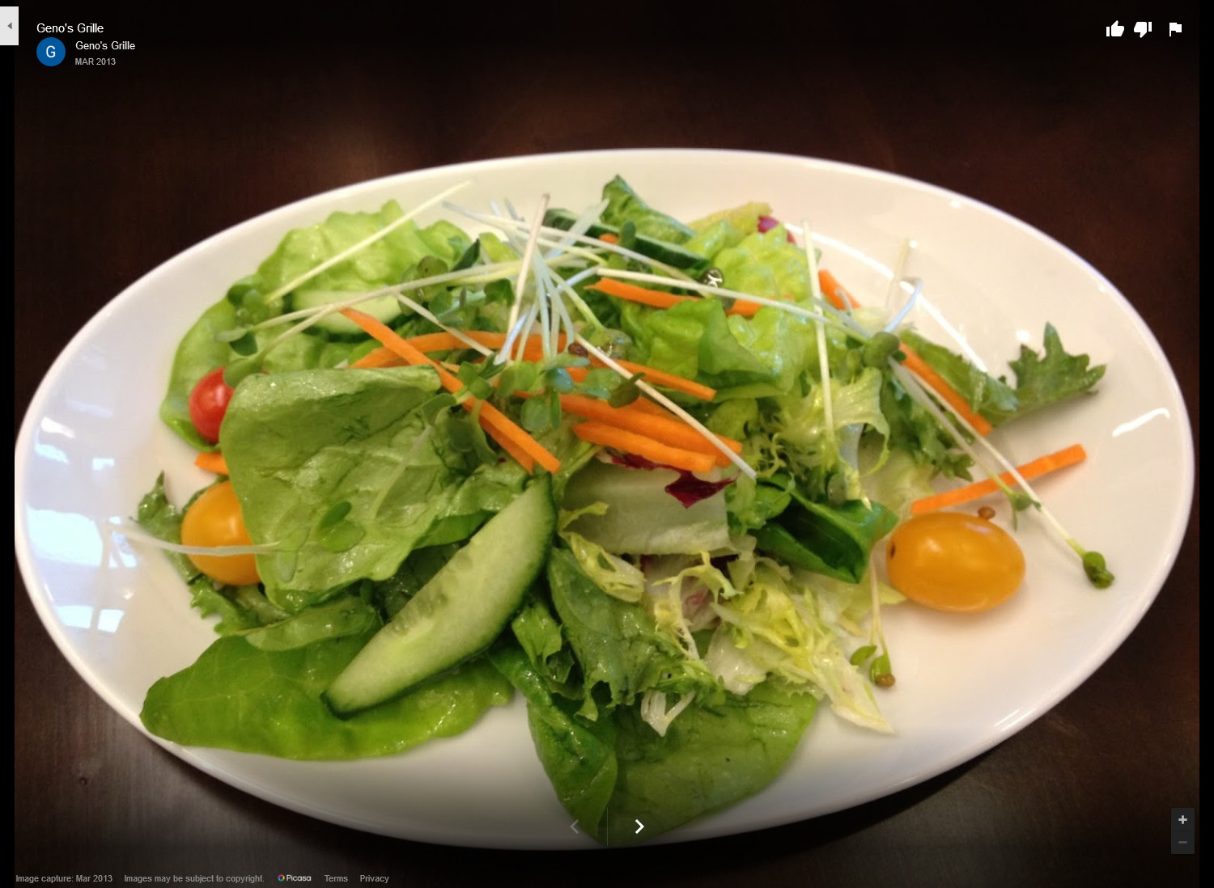

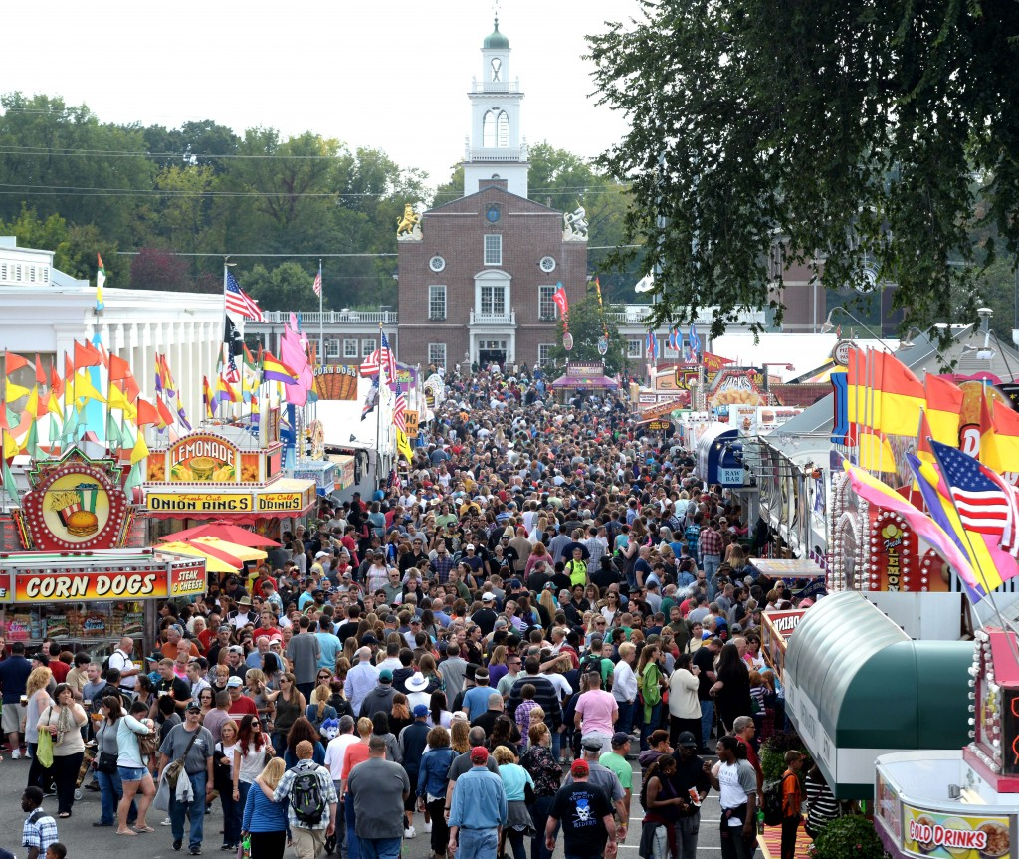
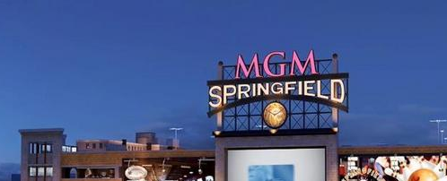
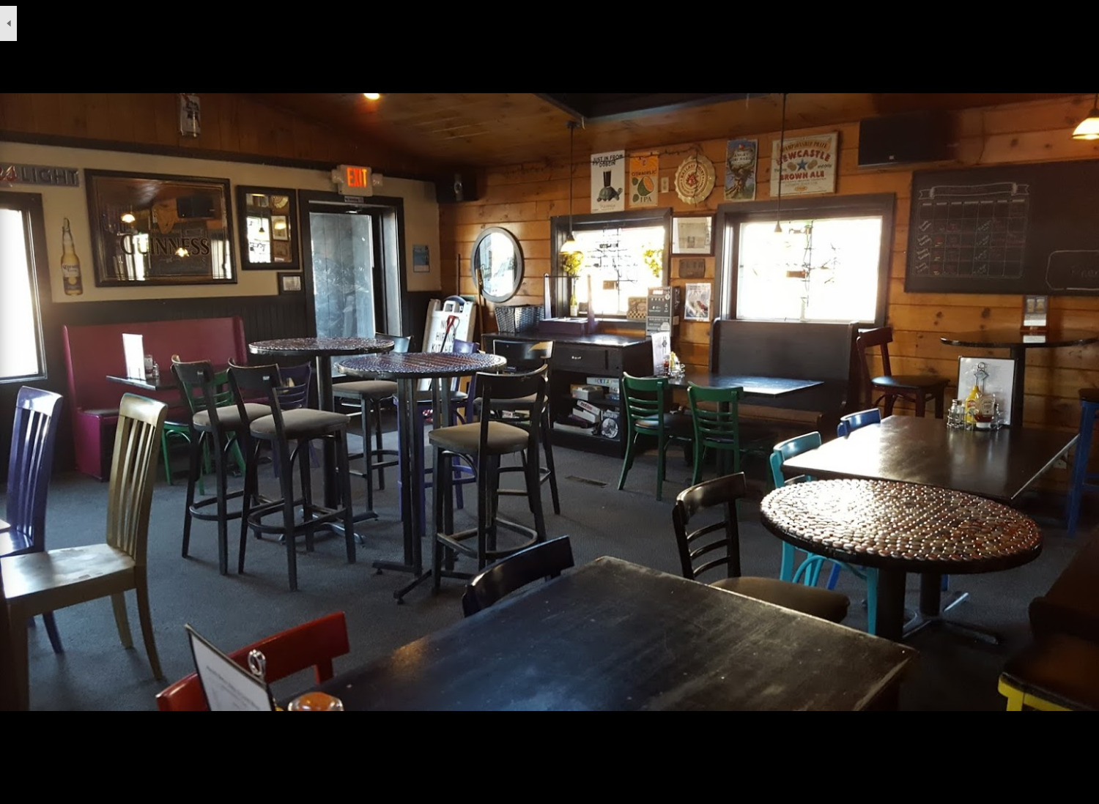
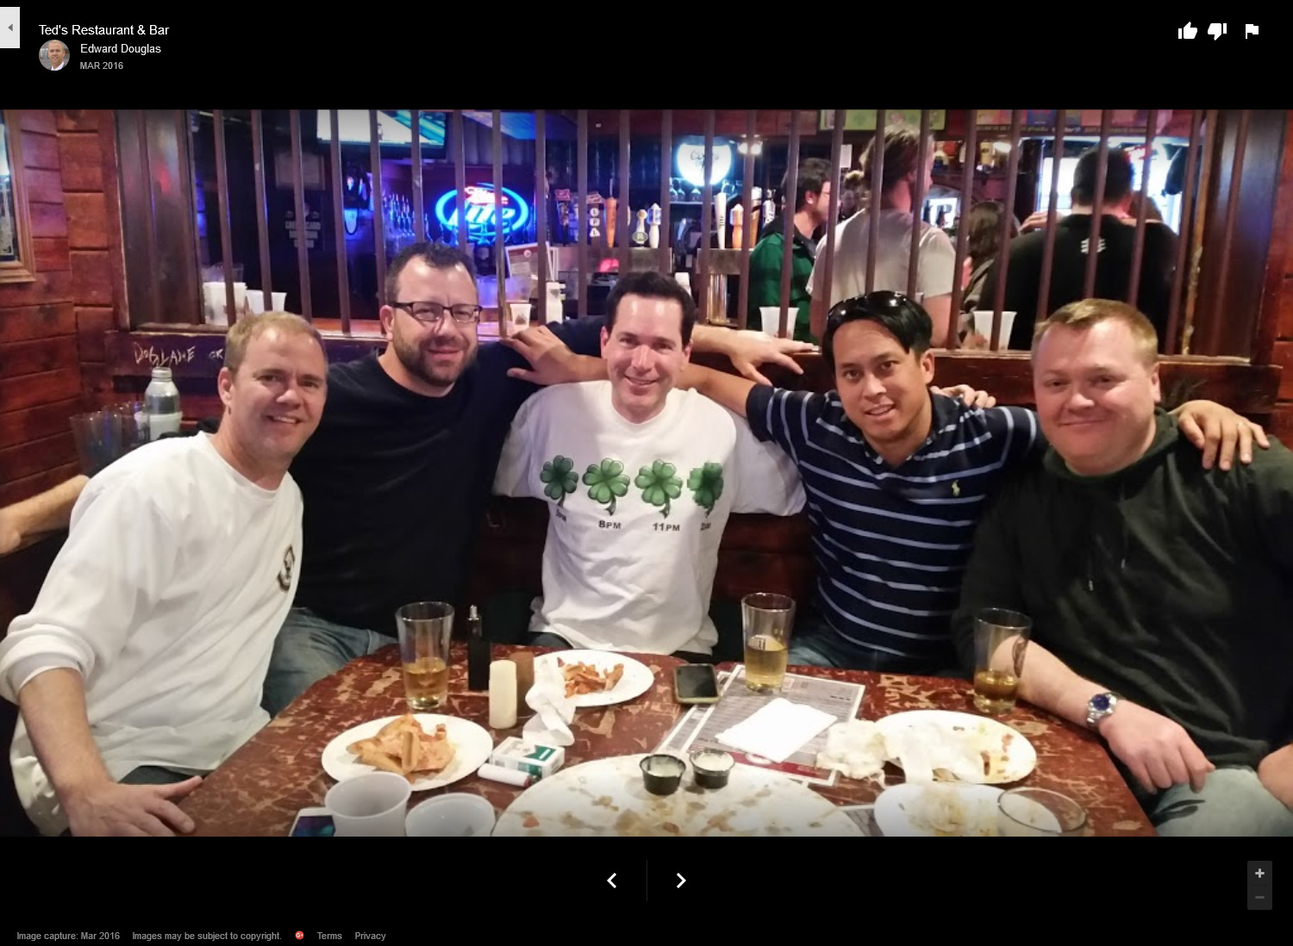
10:00 PM
10:00 PM
10:00 PM
10:00 PM
10:00 PM
10:00 PM
Find your date…
Tori's Profile
Types
Dates
Save
Your Search
Friends
Selected Types
All Set!
Tori has been notified that you're waiting on her response.
Tori
Gail
Selected Places
Popular Near You
•••
•••
UConn Dairy Bar
Ice Cream Shop
Storrs, CT
4.8 ★
278 Reviews
An observation window looks onto the ice cream-making area at this longtime UConn-run scoop shop.
UConn Dairy Bar
Ice Cream Shop
Starbucks
Coffee Shop
UConn Dairy Bar
Ice Cream Shop
Starbucks
Coffee Shop
Easthampton, MA
User profile. Possibly contains information about their location and/or what kind of dates they enjoy.
Mansfield Movieplex
Movie Theater
Geno's Grille
Restaurant
Previous Dates with Tori
Finish
Mansfield Movieplex
Movie Theater
Geno's Grille
Restaurant
Search for date ideas >>
Continue >>
10:00 PM
10:00 PM
Find your date…
Tori's Profile
Friends
Tori
Gail
Popular Near You
UConn Dairy Bar
Starbucks
•••
Easthampton, MA
User profile. Possibly contains information about their location and/or what kind of dates they enjoy.
Geno's Grille
Mansfield Movieplex
Previous Dates with Tori
View Date Search >>

Slide 2
10:00 PM
Title
UConn Dairy Bar
Ice Cream Shop
Gail
UConn Dairy Bar
Ice Cream Shop

